Slide 1
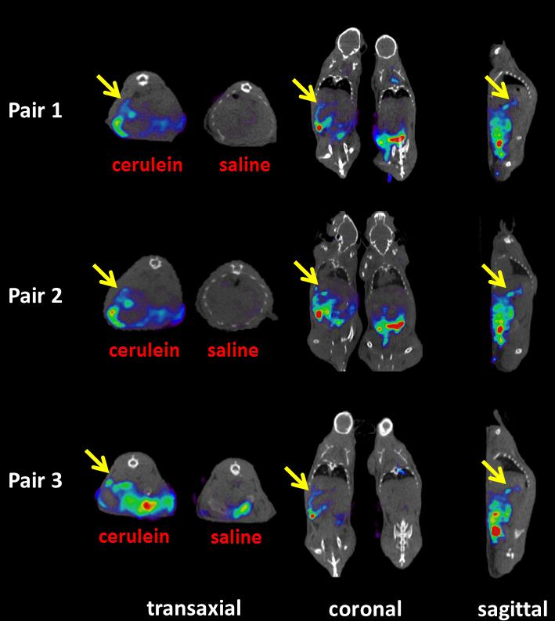
15
Supplemental Figure 1. ¹²⁵I-iodo-DPA-713 SPECT-CT in all pairs of cerulein and saline-treated mice. Each mouse was injected with ̴ 37 MBq (1 mCi) of radiotracer followed by a 24-h uptake period before imaging. Coregistered SPECT and CT images show radiotracer uptake in inflamed cerulein-treated pancreas (arrows) but not in pancreas of vehicle-treated mouse. Scale bar is 0 to 15 SUV.
0
The Journal of Nuclear Medicine • Vol. 58 • No. X • Xxxxxx 2017 Foss et al.

Slide 2
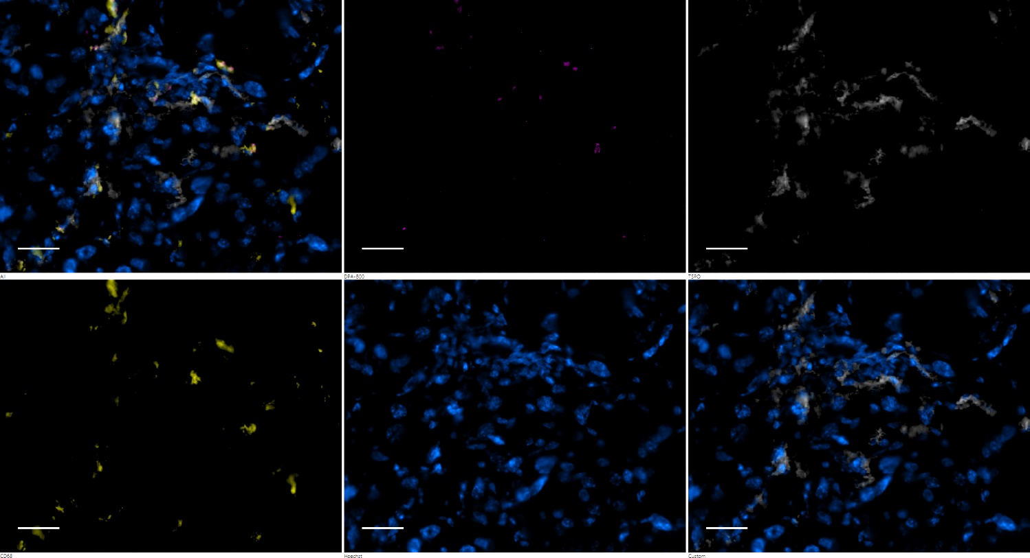
All
ex vivo DPA-IRDye800CW
α-TSPO Ab
α-CD68 Ab
Hoechst
Hoechst + TSPO
Supplemental Figure 2. Ex vivo near IR fluorescence microscopy of DPA-713-IRDye800CW in saline-treated sections of pancreas. The pancreas of the saline-treated mouse in Fig. 3 was removed and cryosectioned to 20-µm thickness and then subsequently probed with anti-CD68 and anti-TSPO antibodies along with Hoechst 33342 to delineate DPA-713-IRDye800CW uptake within infiltrating macrophages. “All” indicates that all channels are displayed. The saline-treated pancreas has nearly no DPA-713-Irdye800CW uptake and few CD68-positive phagocytic cells although displaying characteristically abundant TSPO expression in this neuroendocrine tissue. Scale bar = 50 µm.
The Journal of Nuclear Medicine • Vol. 58 • No. X • Xxxxxx 2017 Foss et al.

Slide 3
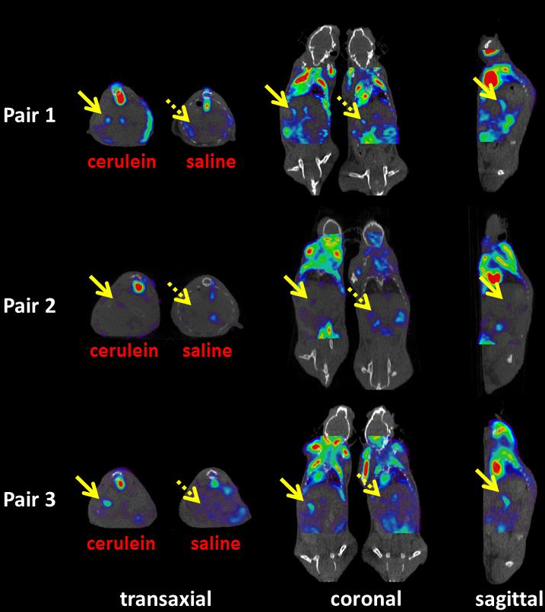
1.2
Supplemental Figure 3. ¹⁸F-FDG PET/CT of all pairs of cerulein- and saline-treated mice. Each mouse was kept fasting or 4 h before injection with 9.25 MBq (250 µCi) of radiotracer followed by a 45-min isoflurane-sedated uptake period before imaging. Coregistered PET and CT images show radiotracer uptake in inflamed cerulein-treated pancreas (solid arrows), with reduced background pancreas uptake seen in vehicle-treated mouse (dotted arrows). Scale bar is 0 to 1.2 SUV.
0
The Journal of Nuclear Medicine • Vol. 58 • No. X • Xxxxxx 2017 Foss et al.

